Slide 1

Artificial neural networks.

Slide 2
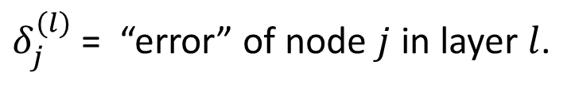
Backpropagation algorithm
$δ_{j}^{(l)}$ = “error” of node $j$ in layer $l$.
For simplicity let us take an arbitrary neuron in a network.
Notes:
Draw the output layer error as the simple difference between the real and predicted result.
Explain with draw that the error get propagated as the node is taking some responsibility (with the weight in the like between neurons) about the error in the previous layer.

Slide 3
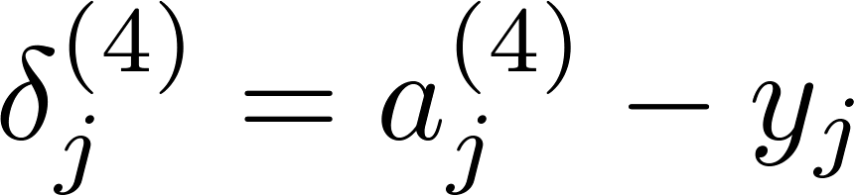
Backpropagation algorithm
For each output unit (layer L = 4)
Notes:
Draw the derivative of the sigmoid function.

Slide 4
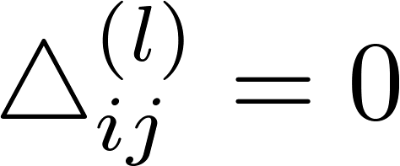


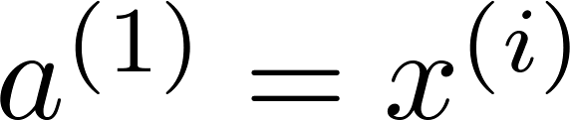

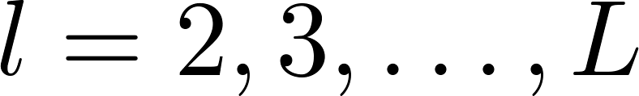

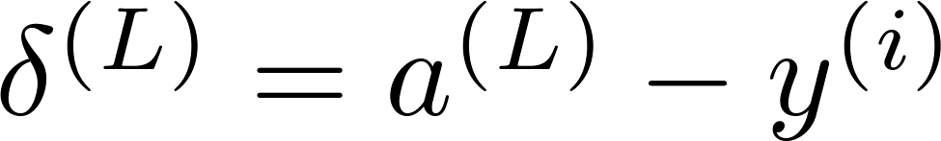
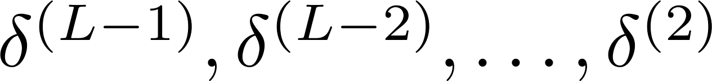
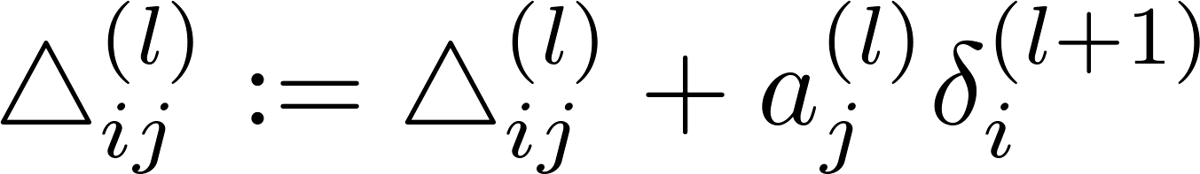
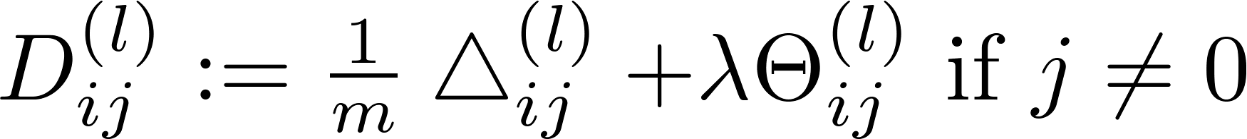
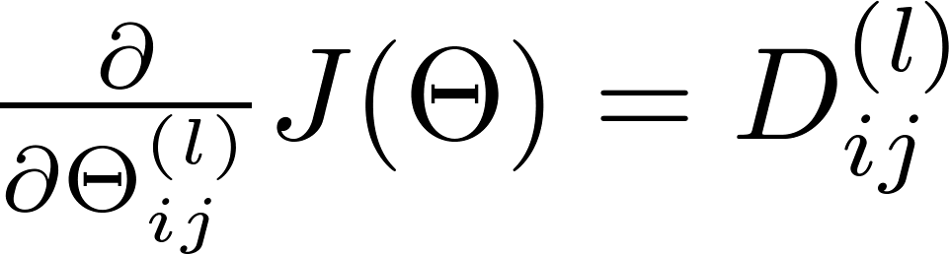
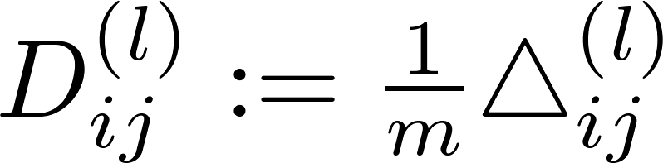

Put it all together
Training set
Set (for all ).
For
Set
Perform forward propagation to compute for
Using , compute
Compute

Slide 5
overfitting & underfitting

Slide 6
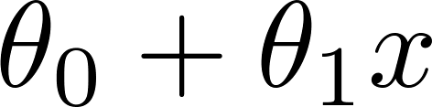
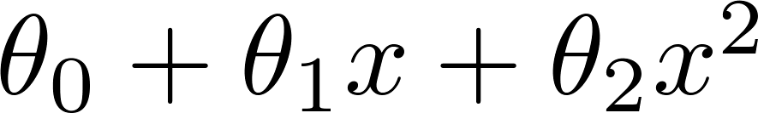
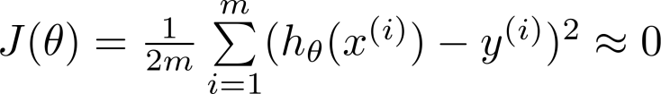
The problem of overfitting & underfitting
Price
Price
Price
Size
Size
Size
Overfitting: If we have too many features, the learned hypothesis may fit the training set very well ( ), but fail to generalize to new examples (predict prices on new examples).

Slide 7
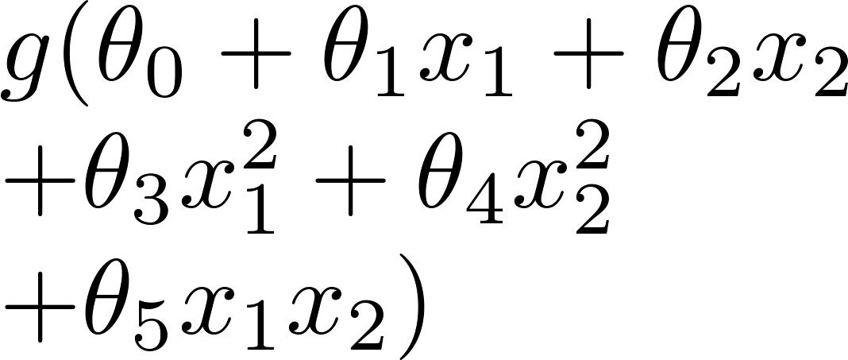
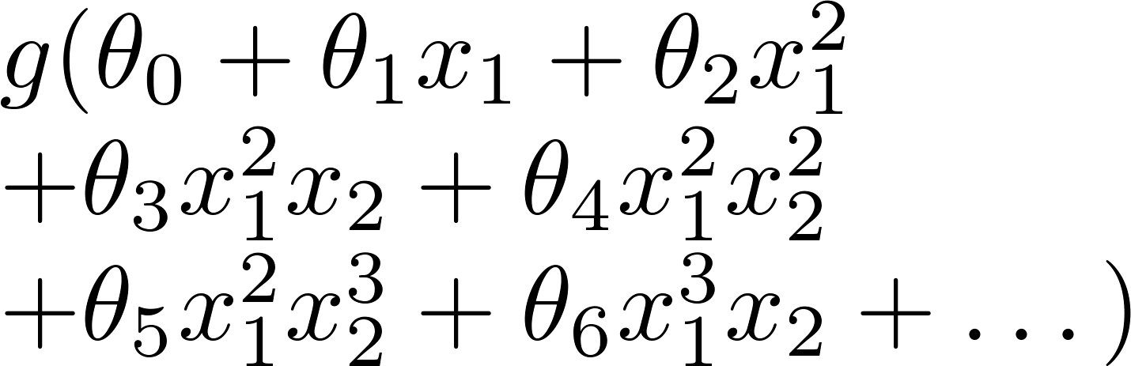
Logistic regression
x₂
x₂
x₂
x₁
x₁
x₁
( = sigmoid function)

Slide 8
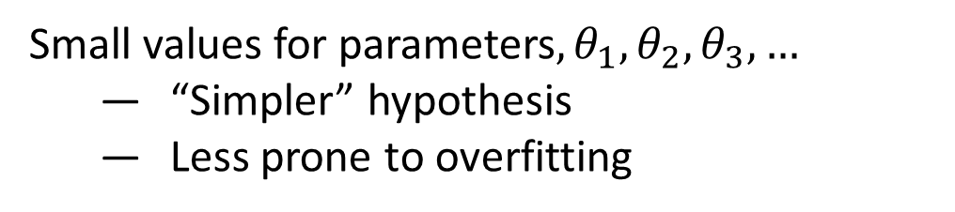
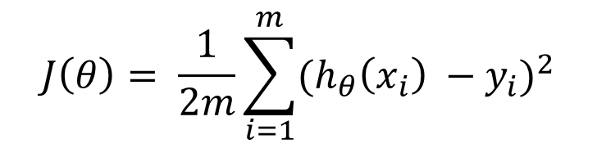
Regularization
Small values for parameters$,θ_{1},θ_{2},θ_{3},…$
“Simpler” hypothesis
Less prone to overfitting
By forcing the optimization to minimize over the parameters
$$J\left(θ\right)= \frac{1}{2m}\sum_{i=1}^{m}{{(h_{θ}\left(x_{i}\right) −y_{i})}^{2}}$$
Notes:
Draw the L2 regularizer with the cost function with $λ$as regularization parameter.
We don’t regularize $θ_{0}$

Slide 9
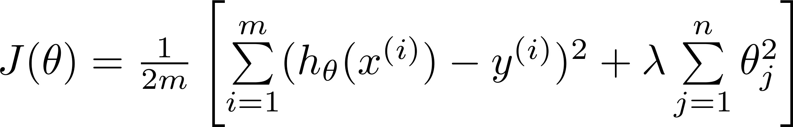
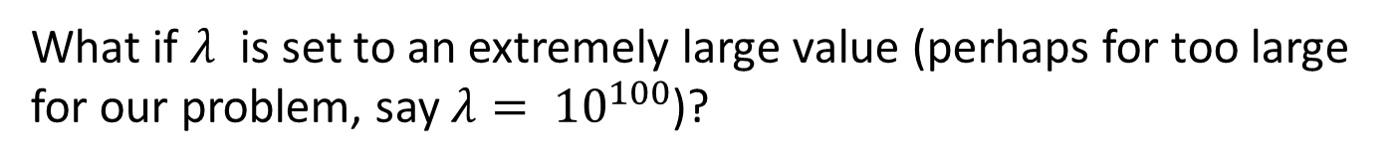
Regularization (Ridge regularizer)
What if $λ$ is set to an extremely large value (perhaps for too large for our problem, say $λ= {10}^{100}$)?
Algorithm works fine; setting to be very large can’t hurt it
Algortihm fails to eliminate overfitting.
Algorithm results in underfitting. (Fails to fit even training data well).
Gradient descent will fail to converge.
Price
Size
Notes:
Draw $y=const.$line showing the underfitting and draw a cross on every $x_{s}$ because the $θ_{s}$

Slide 10
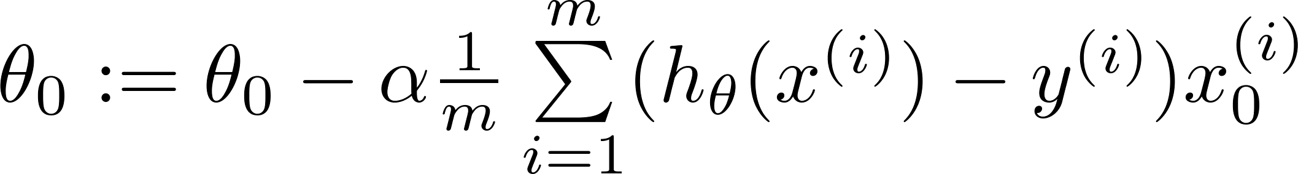
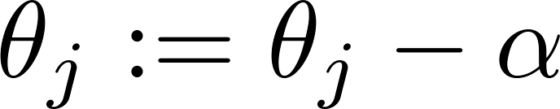

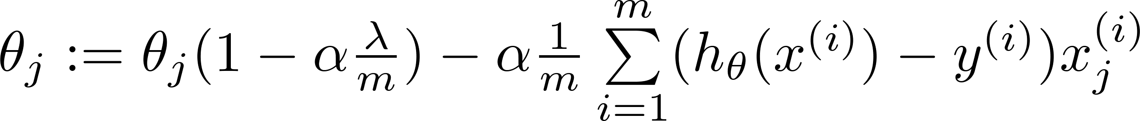
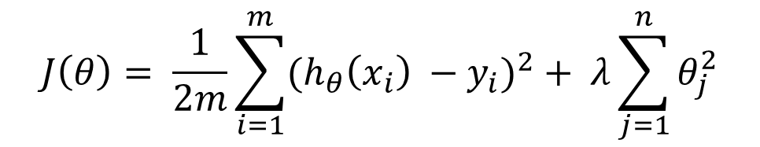
Regularized linear regression
$$J\left(θ\right)= \frac{1}{2m}\sum_{i=1}^{m}{{(h_{θ}\left(x_{i}\right) −y_{i})}^{2}}+ λ\sum_{j=1}^{n}{θ_{j}^{2}}$$
Gradient descent
Repeat
Notes:
Draw the L2 regularizer with the cost function with $λ$as regularization parameter for the gradient decent.
Recall the normal equation $θ={(X^{T}X)}^{−1}X^{T}Y$ from least square, and solve it for the regularized equation $θ={(X^{T}X+ λI)}^{−1}X^{T}Y$.

Slide 11
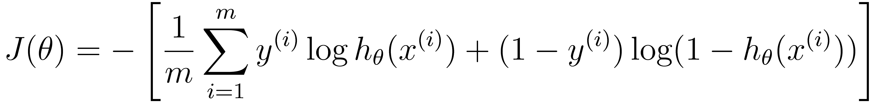
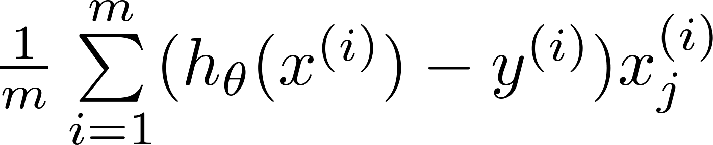

Regularized logistic regression.
Gradient descent
Repeat
Notes:
Draw the L2 regularizer with the cost function with $λ$as regularization parameter.
Also with the gradient decent.

Slide 12
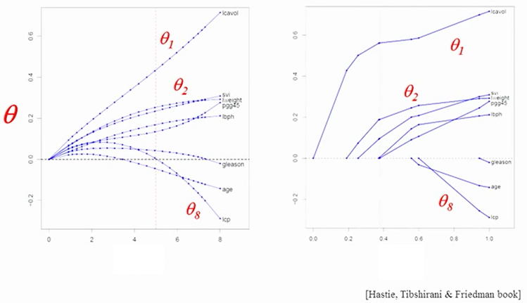


Regularization and feature selection (lasso)
As $λ$ increases, $t(λ)$ decreases and each $θ_{i}$ goes to zero, but too slowly for ridge. Lasso will ensure that irrelevant features $x_{i}$ have weight $θ_{i}$ = 0.
$t(λ)$
$t(λ)$

Slide 13
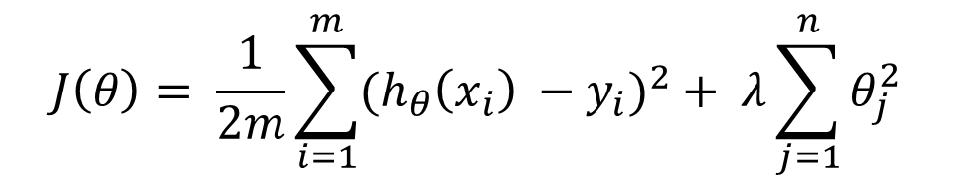
Regularized linear regression
$$J\left(θ\right)= \frac{1}{2m}\sum_{i=1}^{m}{{(h_{θ}\left(x_{i}\right) −y_{i})}^{2}}+ λ\sum_{j=1}^{n}{θ_{j}^{2}}$$
Notes:
Draw the regularization curve of the L2 regularizer and the cost function in the first quarter.

Slide 14
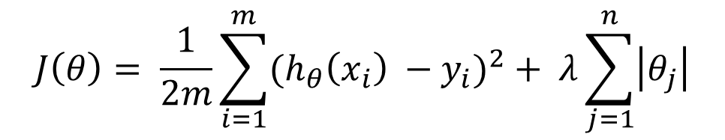
Regularized linear regression
$$J\left(θ\right)= \frac{1}{2m}\sum_{i=1}^{m}{{(h_{θ}\left(x_{i}\right) −y_{i})}^{2}}+ λ\sum_{j=1}^{n}{\left|θ_{j}\right|}$$
Notes:
Draw the regularization curve of the L1 regularizer and the cost function in the first quarter.

Slide 15
Cross validation

Slide 16
Cross validation
Model selection
Almost invariably, all pattern recognition techniques have one or more free parameters (hyperparameters)
The number of neighbours in a kNN classification rule
The network size, learning parameters and weights in MLPs
How do we select the “optimal” parameter(s) or model for a given classification problem?
Performance estimation
One approach is to use the entire training data to select our classifier and estimate the error rate.
The final model will normally overfit the training data (large parameter model).
The error rate estimate will be overly optimistic (lower than the true error rate) .

Slide 17
Solution
Three way cross validation
Split dataset into two groups:
Training set: used to train the classifier
Validation set: used to modify the hyperparameter
Test set: used to evaluate the trained classifier
Split dataset into two groups:
Training set: used to train the classifier
Test set: used to evaluate the trained classifier
But what to do for the hyperparameters ?
If we modify (tune) the hyperparameter on the result from the test set, we actually have roing the error form the test set.
data
train
validation
test
data
train
validation
After assessing the final model with the test set, YOU MUST NOT further tune the model

Slide 18
K-Fold Cross-validation
Split dataset into k groups:
For each of K experiments, use K-1 folds for training and the remaining one for testing.
data
validation
train
K = 1
train
validation
train
K = 2
train
validation
train
K = 3
train
validation
K = 4
The advantage of K-Fold Cross validation is that all the examples in the dataset are eventually used for both training and testing.

Slide 19
How many folds are needed?
With a large number of folds + The bias of the true error rate estimator will be small (the estimator will be very accurate). - The variance of the true error rate estimator will be large. - The computational time will be very large as well (many experiments).
With a small number of folds + The number of experiments and, therefore, computation time are reduced. + The variance of the estimator will be small. - The bias of the estimator will be large (conservative or higher than the true error rate).
In practice, the choice of the number of folds depends on the size of the dataset
For large datasets, even 3-Fold Cross Validation will be quite accurate
For very sparse datasets, we may have to use leave-one-out in order to train on as many examples as possible.
A common choice for K-Fold Cross Validation is K=10
Notes:
Leave-one-out is the degenerate case of K-Fold Cross Validation, where K is chosen as the total number of examples
For a dataset with N examples, perform N experiments.
For each experiment use N-1 examples for training and the remaining example for testing As usual, the true err

Slide 20

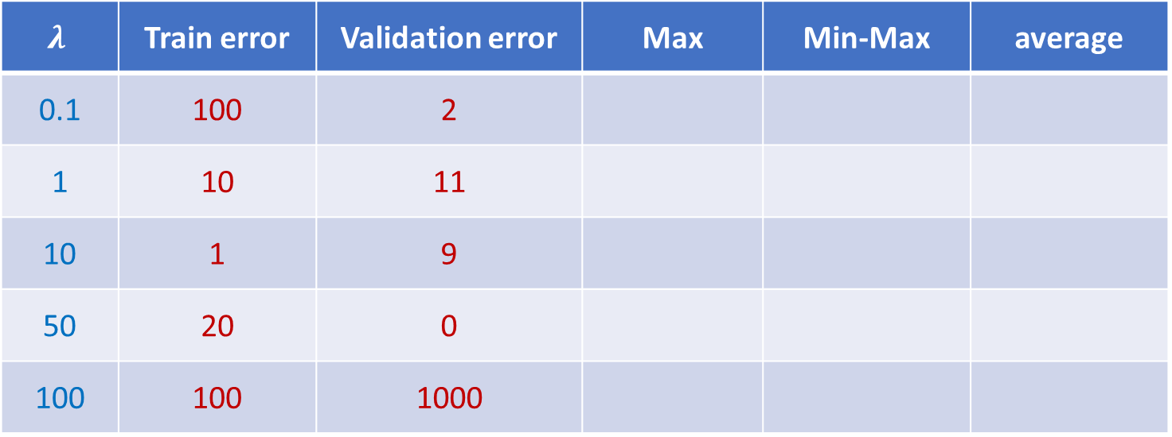
How to choose the hyperparameter
Taking the learning rate $λ$ for simplicity
$$λ$$ | Train error | Validation error | Max | Min-Max | average
0.1 | 100 | 2
1 | 10 | 11
10 | 1 | 9
50 | 20 | 0
100 | 100 | 1000

